Slide 1

SAI VIDYA INSTITUTE OF TECHNOLOGY Accredited by NBA New Delhi (CSE, ECE, ISE, MECH, CIVIL), NAAC-“A” Grade
Department of Computer Science and Engineering
Rajanukunte, Bengaluru – 560064
Project Phase -2 Final Presentation- 2023-24
Weapon Detection And Alert System In ATM Using YOLO
By
Anagha Tholpady S 1VA20CS009
Niveditha M Hiremath 1VA20CS035
Sannidhi N Reddy 1VA20CS047
Sevanthi G Meti 1VA20CS048
Under the guidance of :
Prof.Manjusha P K
Assistant Professor
Dept. of CSE

Slide 2
Introduction
In today's modern world, safety and security are big concerns. Daily, banks and shops are robbed, and the ratio of robberies is increasing eventually. So, there is a need for such a safety system that minimizes the chances of robbery and helps keep the peace and safety maintained.
Mostly CCTV (Closed-circuit Television) surveillance system is used, which is quite inefficient due to the dependency on the human factor. Adding AI (Artificial Intelligence) i.e., Object Detection in the system will not only be efficient in discernment but will also identify the potential threat in much less time.
The project uses the latest object detection technique YOLO (You Only Look Once) to identify handguns and rifles, with training on the data set of images, through a camera.
Dept. of CSE, SVIT 2

Slide 3
Problem Statement
Develop an innovative and efficient weapon detection and alert system for ATM security by leveraging the YOLO (You Only Look Once) deep learning framework, aiming to enhance the safety of ATM users and protect against potential threats and criminal activities in real-time.
Dept. of CSE, SVIT 3

Slide 4
Literature Survey
Sl no. | Paper title | Authors | Description
1. | Weapon detection system using deep learning | P Murugan , A.Merry ida , R Aashika , S.Amshiga Brillian , M.Seals Ancy , S.Sneha | In recent years, computer vision technology has been used for realtime weapon detection, and the YOLO (You Only Look Once) object detection algorithm has emerged as a popular and efficient technique for this purpose. In this report, we learn the use of YOLO for weapon detection, and its performance in identifying firearms, knives, and other weapons.
2. | Armament Detection And Alerting System Using YOLOV3 | Shashank Shet K1 , Parth P Shah2 , Rohith R3 | The objective here is to develop a prototype which will visually detect the weapons in real time videos and alert upon successful detection. We have learnt about an algorithm called YOLOV3.
Dept. of CSE, SVIT 4

Slide 5
Literature Survey
Sl no. | Paper title | Authors | Description
3. | Implementation of Human Action Recognition using Image Parsing Techniques | Soumalya Sen, Moloy Dhar and Susrut Banerjee. | Image Parsing Techniques The Lucas– Kanade method assumes that the displacement of the image contents between two nearby instants (frames) A Human action is recognized by using vision BlobAnalysis object
4. | Automatic Action Unit Detection in Infants Using Convolutional Neural Network | Zakia Hammal1, Wen-Sheng Chu1, Jeffrey F. Cohn,Carrie Heike, and Matthew L. Speltz. | CNN is used to measure facial expressiveness. Automatic detection of facial expressiveness in infants is in the early stages. Expression depends only by facial landmarks
Dept. of CSE, SVIT 5

Slide 6
Existing System
ATM’s have cameras where the footage is just recorded and stored in storage.
Does not have intelligence of any weapon detection.
There are buzzers which only gets activated when someone press it, there is no automation.
Security guards have to check persons activity and take action.
Dept. of CSE, SVIT 6

Slide 7
Proposed System
A deep learning model with YOLO has been trained with many classes.
We have used YOLOv3 model to detect Gun or knife.
In case of any Gun or Knife is seen in ATM then the camera captures the image immediately with the help of YOLO model and immediately sends an email alert with image to the an authorized person.
The system also triggers voice alert “weapon detected”.
The system is completely automated hence no interference of human is required to alert.
Dept. of CSE, SVIT 7

Slide 8
System Requirement Specification
Hardware Requirements:
CAMERA : System Web CAM
PROCESSOR : Above intel i3
HARD DRIVE : >10GB
RAM : Minimum 4GB
Software Requirements:
OS : Windows above 8
LANGUAGE : Python
IDE : Python Idle
FRONT END : Tkinter
Dept. of CSE, SVIT 8

Slide 9
System Architecture
LIVE FEED FROM CAMERA
DEEPLEARNING YOLO MODEL
DETECT WEAPON
ALERT
BUZZER
MAIL ALERT
Figure 1 : System architecture of Weapon detection in ATMs using YOLO
Dept. of CSE, SVIT 9

Slide 10
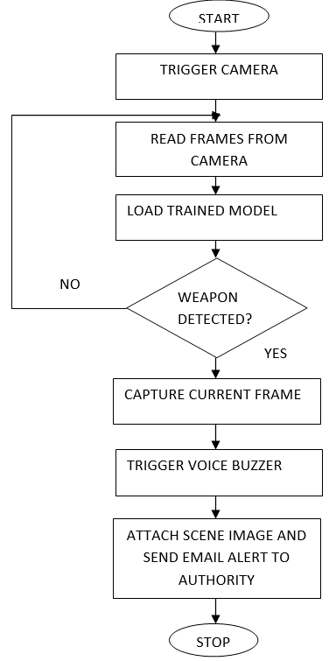
Flow Chart
Figure 2 : Flow Chart Diagram
Dept. of CSE, SVIT 10

Slide 11
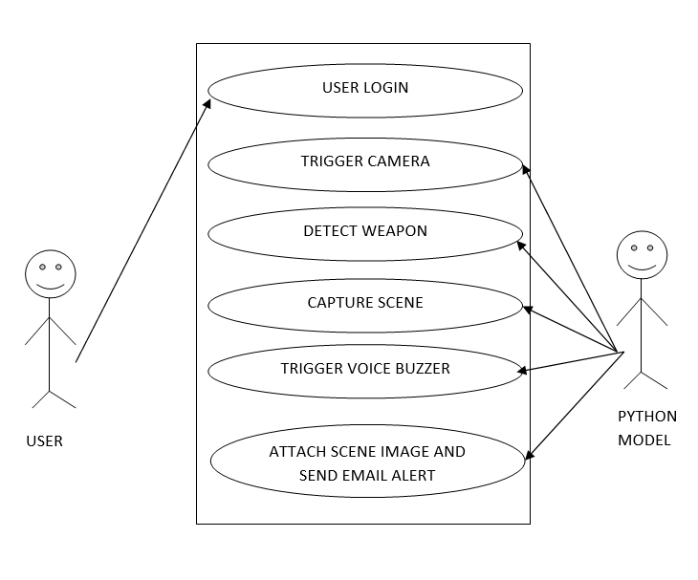
Use Case
Figure 3 : Use Case Diagram
Dept. of CSE, SVIT 11

Slide 12
Project Modules
Tkinter – to build the interface
Sys – to communicate with system folders.
Cv2 – open source computer vision library used to trigger the camera , read the frames from camera
Numpy – deals with array type of operation
Pyttsx3 – converts text to voice format.
Sendmail – used to send mail
Dept. of CSE, SVIT 12

Slide 13
Implementation
What is YOLO?
YOLO is an abbreviation for the term ‘You Only Look Once’. This is an algorithm that detects and recognizes various objects in a picture (in real-time).
YOLO algorithm employs convolutional neural networks (CNN) to detect objects in real-time.
YOLO algorithm works using the following three techniques:
Residual blocks
Bounding box regression
Intersection Over Union (IOU)
Dept. of CSE, SVIT 13

Slide 14
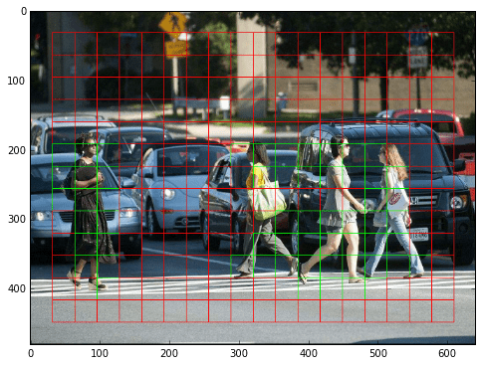
Implementation
Residual Blocks
First, the image is divided into various grids. Each grid has a dimension of S x S.
The following image shows how an input image is divided into grids.
Figure 4 : Residual Blocks
Dept. of CSE, SVIT 14

Slide 15
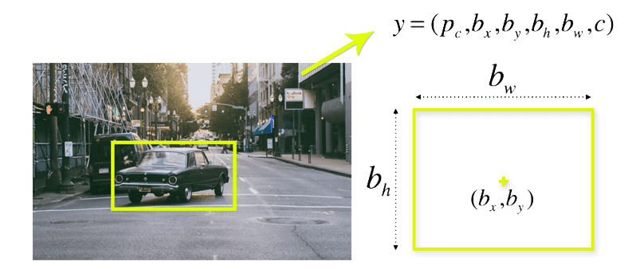
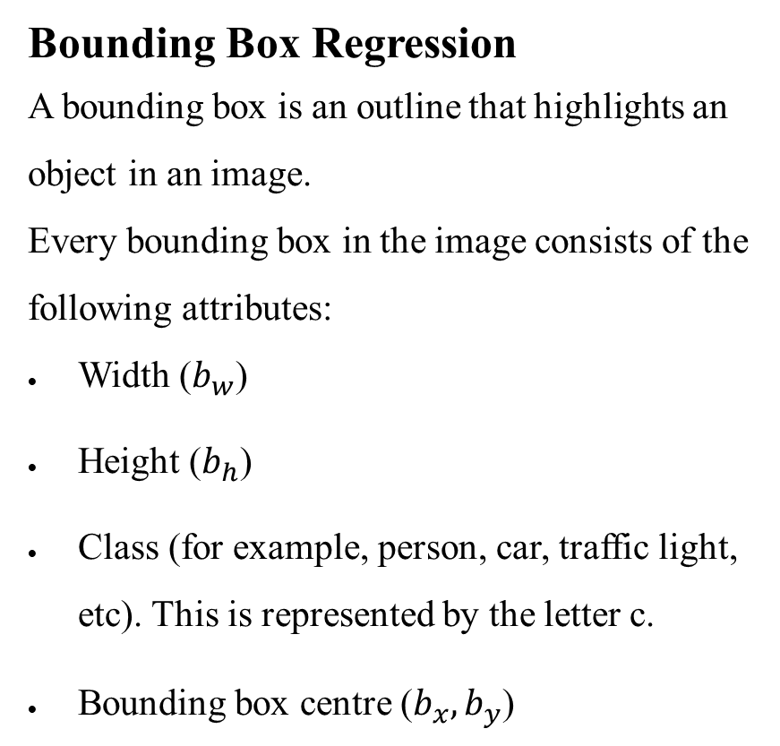
Implementation
Bounding Box Regression
A bounding box is an outline that highlights an object in an image.
Every bounding box in the image consists of the following attributes:
Width ($b_{w}$)
Height ($b_{h}$)
Class (for example, person, car, traffic light, etc). This is represented by the letter c.
Bounding box centre ($b_{x}, b_{y}$)
Figure 5 : Bounding Box
Dept. of CSE, SVIT 15

Slide 16
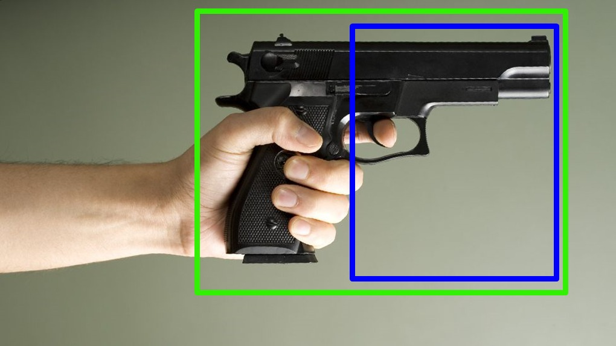
Implementation
Intersection Over Union (IOU)
Intersection over union (IOU) is a phenomenon in object detection that describes how boxes overlap. YOLO uses IOU to provide an output box that surrounds the objects perfectly.
Figure 6 : IOU
Dept. of CSE, SVIT 16

Slide 17
Implementation
Steps in YOLOv3
1. Input Image
2. Image Preprocessing
3. Neural Network Backbone
4. Feature Extraction
5. Detection Layers
6. Bounding Box Prediction
7. Confidence Score Calculation
8. Class Prediction
9. Non-max Suppression
10. Output
Dept. of CSE, SVIT 17

Slide 18
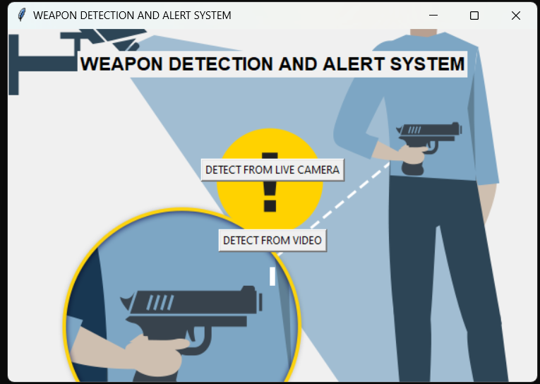
Snapshots
Figure 7 : Weapon detection and alert system is installed in the ATM
Dept. of CSE, SVIT 18

Slide 19
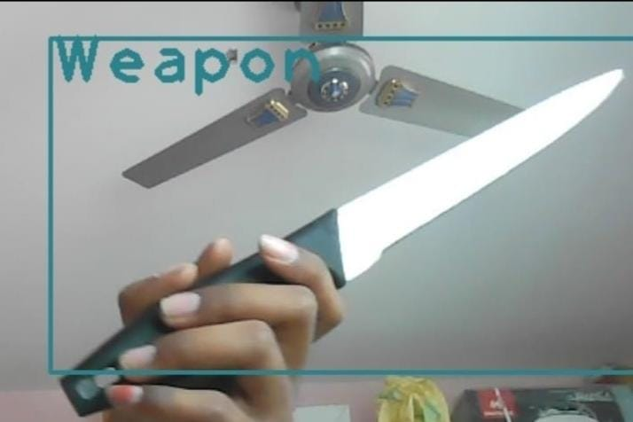
Snapshots
Figure 8 : Weapon detected image sent in email
Dept. of CSE, SVIT 19

Slide 20
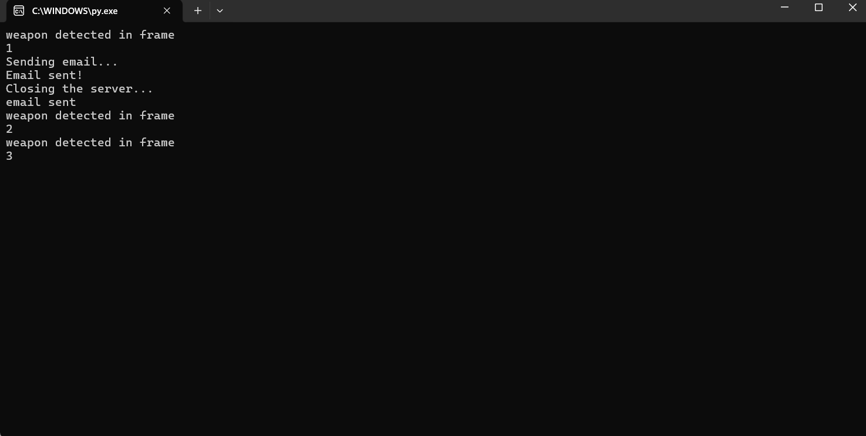
Snapshots
Figure 9 : Weapon is detected from a frame and alert is generated
Dept. of CSE, SVIT 20

Slide 21
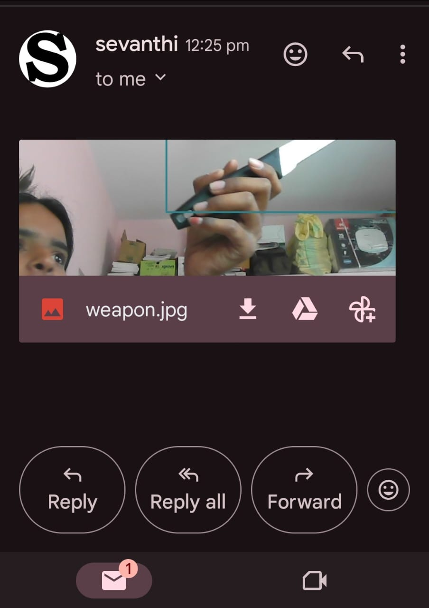
Snapshots
Figure 10 : Email is sent to relevant authority
Dept. of CSE, SVIT 21

Slide 22
Conclusion
Implementing this project in ATMs enhance security by using real time object detection capabilities.
With YOLO’s accuracy ,the system can identify weapons, triggers immediate alert to an authority.
The project’s scope can be increased to concealed weapon detection by adding metal detectors or thermal cameras.
Dept. of CSE, SVIT 22

Slide 23
Reference
[1] Shashank Shet K1 , Parth P Shah2 , Rohith R3, “Armament Detection And Alerting System Using YOLOV3”.
[2] P Murugan1 , A.Merry ida2 , R Aashika3 , S.Amshiga Brillian4 , M.Seals Ancy5 , S.Sneha “Weapon Detection System Using Deep Learning.”
[3] S. Narejo, B. Pandey, C. Rodriguez, M. R. Anjum et al., “Weapon detection using yolo v3 for smart surveillance system,” Mathematical Problems in Engineering .
[4] U. Nepal and H. Eslamiat, “Comparing yolov3, yolov4 and yolov5 for autonomous landing spot detection in faulty uavs,” Sensors.
[5]“Ultralytics/yolov5: Yolov5 in pytorch onnx coreml tflite.” [Online].Available: https://github.com/ultralytics/yolov5.
Dept. of CSE, SVIT 23

